Slide 1
SUN- The Cosmic Powerhouse
Lunar Astro

Slide 2
Sun- The Cosmic Powerhouse
Sun- The cosmic powerhouse which gives energy to the universe. When the Sun is well placed in the birth chart, the native will be able to work in life with great intensity as the powerhouse is strong and so is willpower of any native.
Sun burns the house where it sits, and this house you will not be able to relax, you can see major events at the age by following Sun Cycle.
1st House Sun- 22 - 2nd House Sun -23 and by this 12th house Sun will be 34.

Slide 3


Activation Ages
House - Age
1 22
2 23
3 24
4 25
5 26
6 27
7 28
8 29
9 30
10 31
11 32
12 33
There are different ages at which Sun activates-One of the activation ages is about maturing when native completes something in life, Such as an Important degree or milestone.
One of such activation age table is given below.

Slide 4
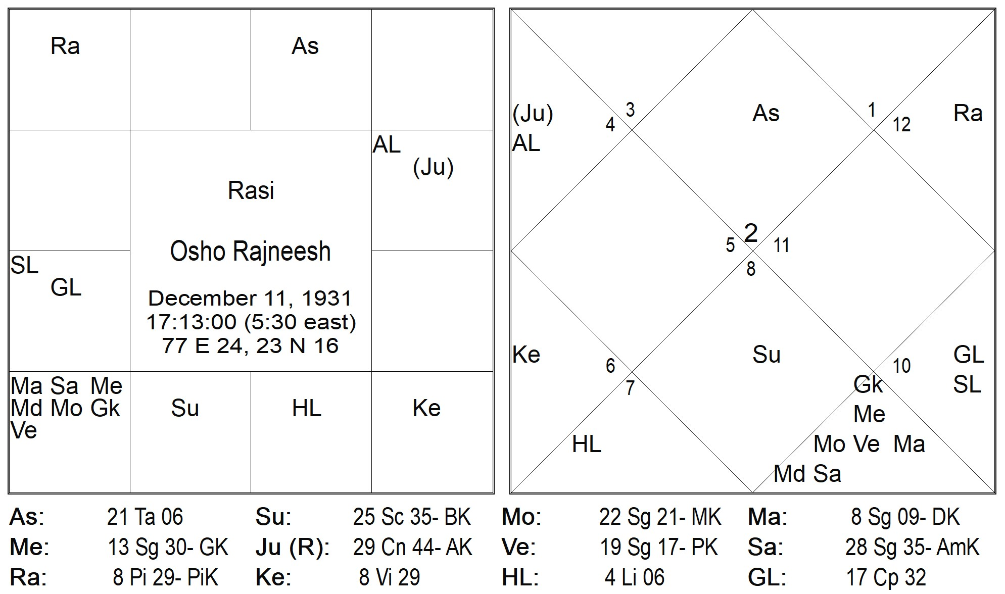
Example-1
7th House Sun- Activation year 28
7th House is position, Status, Marriage, Social recognition
At the age of 28 Osho became Professor at Jabalpur University- Gained title.
Next Activation 1970- Osho declared himself as Bhagwan Osho Rajneesh-again gained title.

Slide 5
Example-1
7th rules 4th house in this chart of properties and shows problem of property but why in the age of 51 not early, think about it.
As the this was the age of activation when he purchased land in oregon and problems with government started.
4th lord Sun again got activated and this time problem with government happened.

Slide 6
Example-1
This was the last circle of Sun as Sun has completed his karma with 4th house of Land and 7th house of sexuality and now there is no more fuel in Sun and the next cycle will not repeat.
This also gives us clue on ayu of any native based on luminaries in chart.

Slide 7
My curiosity- I thought let us see Dasa as well.

Slide 8
Example-1
For Someone like Osho you should use Atmakarka to see experiences of Soul and in AK Kendradi Dasa -He was running Sun Dasa which is 4th lord from lagna and placed in 5th house from AK started 1979 - The exact time period when problems with govt started in India.
AK placed in Cancer sign- These natives have karmic relation to land, places

Slide 9
Example-1
This was the last circle of Sun as Sun has completed his karma with 4th house of Land and 7th house of sexuality and now there is no more fuel in Sun and the next cycle will not repeat.
This also gives us clue on ayu of any native based on luminaries in chart.

Slide 10
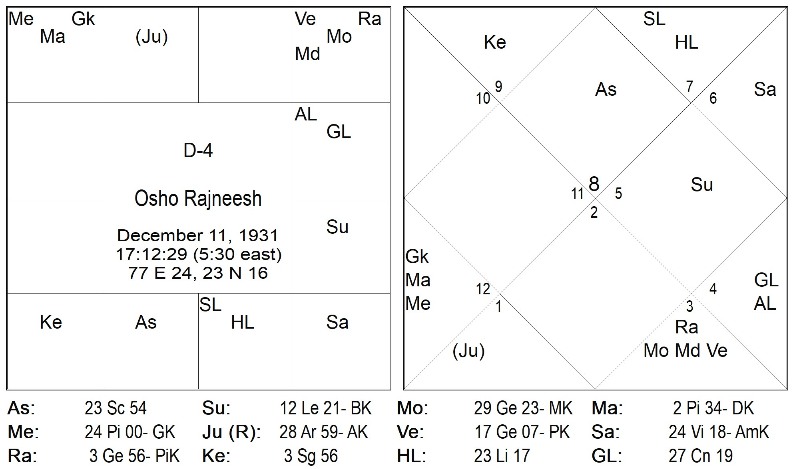
In D-4 Chart - he was running dasa of 2nd and 5th lord Jupiter which is placed in 6th house of dispute but also the dispositor gets combined with 8th lord of D-4.
The antardasa of 4th lord of D-4 which is now aspected by 6/8 lord of chart made both dasa and antardasa lord crippled.

